Slide 1
Intelligent Agents
Chapter 2 – AIMA
Dr. Aarij Mahmood Hussaan

Slide 2
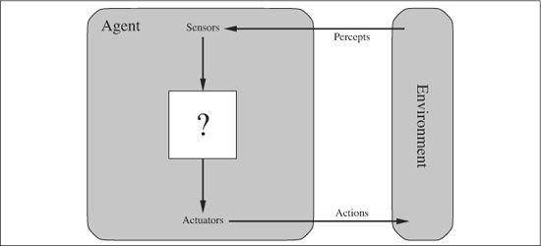
What is an (Intelligent) Agent?
An over-used, over-loaded, and misused term.
Anything that can be viewed as perceiving its environment through sensors and acting upon that environment through its actuators to maximize progress towards its goals.

Slide 3
What is an (Intelligent) Agent?
PAGE
(Percepts, Actions, Goals, Environment)
PEAS[AIMA]
(Performance, Environment, Actuators, Sensors)
Task-specific & specialized: well-defined goals and environment
The notion of an agent is meant to be a tool for analyzing systems,
It is not a different hardware or new programming languages

Slide 4
Agent
Percept
agent’s perceptual inputs at any given instant
Percept Sequence
the complete history of everything the agent has ever perceived
Agent’s action depends upon the complete history of percept sequence to date

Slide 5
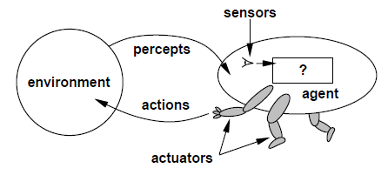
Agents and environments
Agents include humans, robots, softbots, thermostats, etc.
The agent function maps from percept histories to actions:
f : P* → A
The agent program runs on the physical architecture to produce f

Slide 6
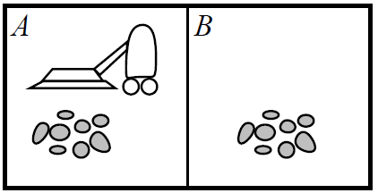
Vacuum-cleaner world
Percepts: location and contents, e.g., [A;Dirty]
Actions: Left, Right, Suck, NoOp

Slide 7
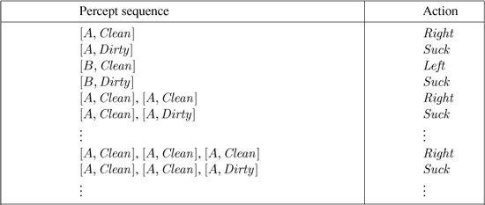
A vacuum-cleaner agent
function Reflex-Vacuum-Agent( [location,status]) returns an action
if status = Dirty then return Suck
else if location = A then return Right
else if location = B then return Left
What is the right function?
Can it be implemented in a small agent program?

Slide 8
Rationality
Fixed performance measure evaluates the environment sequence
one point per square cleaned up in time T?
one point per clean square per time step, minus one per move?
penalize for > k dirty squares?
A rational agent chooses whichever action maximizes the expected value of the performance measure given the percept sequence to date
Rational != omniscient
percepts may not supply all relevant information
Rational != clairvoyant
action outcomes may not be as expected
Hence, rational != successful
Rational => exploration, learning, autonomy

Slide 9
Agent
To design a rational agent, we must specify the task environment
Consider, e.g., the task of designing an automated taxi:
Performance measure??
Environment??
Actuators??
Sensors??

Slide 10
Agent
To design a rational agent, we must specify the task environment
Consider, e.g., the task of designing an automated taxi:
Performance measure?? safety, destination, profits, legality, comfort, ..
Environment?? streets/highways, tracks, pedestrians, weather,
Actuators?? steering, accelerator, brake, horn, speaker/display,….
Sensors?? video, accelerometers, gauges, engine sensors, keyboard, GPS, :…

Slide 11
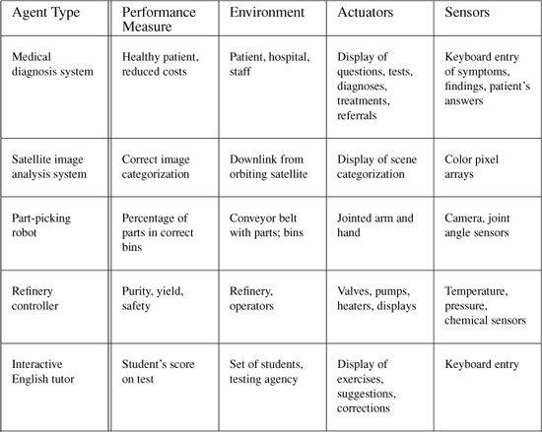
Some more examples

Slide 12
A Windshield Wiper Agent
Goals:?
Percepts:?
Sensors:?
Actuators: ?
Actions:?
Environment: ?

Slide 13
A Windshield Wiper Agent
Goals: Keep windshields clean & maintain visibility
Percepts: Raining, Dirty
Sensors: Camera (moist sensor)
Actuators: Wipers (left, right, back)
Actions: Off, Slow, Medium, Fast
Environment: Inner city, freeways, highways, weather …

Slide 14
Internet shopping agent
Performance measure?? price, quality, appropriateness, efficiency
Environment?? current and future WWW sites, vendors, shippers
Actuators?? display to user, follow URL, fill in form
Sensors?? HTML pages (text, graphics, scripts)

Slide 15
Interacting Agents
Collision Avoidance Agent (CAA)
Goals : Avoid running into obstacles
Percepts: ?
Sensors:?
Actuators:?
Actions: ?
Environment: Freeway
Lane Keeping Agent (LKA)
•Goals : Stay in current lane
•Percepts:?
•Sensors:?
•Actuators:?
•Actions:?
•Environment: Freeway

Slide 16
Interacting Agents
Collision Avoidance Agent (CAA)
Goals : Avoid running into obstacles
Percepts: Obstacle distance, velocity, trajectory
Sensors: Vision, proximity sensing
Actuators : Steering Wheel, Accelerator, Brakes, Horn, Headlights
Actions : Steer, speed up, brake, blow horn, signal (headlights)
Environment: Freeway
Lane Keeping Agent (LKA)
•Goals : Stay in current lane
•Percepts: Lane center, lane boundaries
•Sensors: Vision
•Actuators: Steering Wheel, Accelerator, Brakes
•Actions: Steer, speed up, brake
•Environment: Freeway

Slide 17
Conflict Resolution by Action Selection Agents
Override: CAA overrides LKA
Arbitrate: if Obstacle is Close then CAA else LKA
Compromise: Choose action that satisfies both agents
Any combination of the above
Challenges: Doing the right thing

Slide 18
Behavior and performance of IAs
Perception(sequence) to Action Mapping: f : P* → A
◦Ideal mapping: specifies which actions an agent ought to take at any point in time
◦Description: Look-Up-Table, Closed Form, etc.
Performance measure: a subjective measure to characterize how successful an agent is (e.g., speed, power usage, accuracy, money, etc.)
(degree of) Autonomy: to what extent is the agent able to make decisions and take actions on its own?

Slide 19
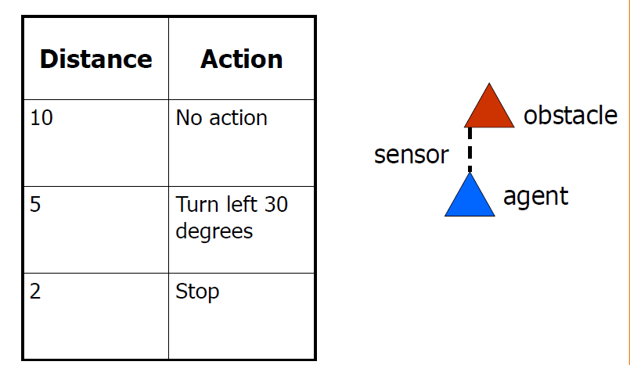
Look up table

Slide 20
Closed form
Output (degree of rotation) = F(distance)
E.g., F(d) = 10/d (distance cannot be less than 1/10)

Slide 21
How is an Agent different from other software?
Agents are autonomous, that is, they act on behalf of the user
Agents contain some level of intelligence, from fixed rules to learning engines that allow them to adapt to changes in the environment
Agents don't only act reactively, but sometimes also proactively
Agents have social ability, that is, they communicate with the user, the system, and other agents as required
Agents may also cooperate with other agents to carry out more complex tasks than they themselves can handle
Agents may migrate from one system to another to access remote resources or even to meet other agents

Slide 22
Environment types
Fully observable vs. partially observable
Single agent vs. multi-agent
Deterministic vs. stochastic
Episodic vs. sequential
Static vs. dynamic
Discrete vs. continuous
(Known vs. unknown)

Slide 23
Environment types
 | Solitaire | Chess | Internet Shopping | Taxi
Observable?
Deterministic?
Episodic?
Static?
Discrete?
Single-agent?

Slide 24
Environment types
 | Solitaire | Chess | Internet Shopping | Taxi
Observable? | Yes | Yes | No | No
Deterministic?
Episodic?
Static?
Discrete?
Single-agent?

Slide 25
Environment types
 | Solitaire | Chess | Internet Shopping | Taxi
Observable? | Yes | Yes | No | No
Deterministic? | Yes | No | Partly | No
Episodic?
Static?
Discrete?
Single-agent?

Slide 26
Environment types
 | Solitaire | Chess | Internet Shopping | Taxi
Observable? | Yes | Yes | No | No
Deterministic? | Yes | No | Partly | No
Episodic? | No | No | No | No
Static?
Discrete?
Single-agent?

Slide 27
Environment types
 | Solitaire | Chess | Internet Shopping | Taxi
Observable? | Yes | Yes | No | No
Deterministic? | Yes | No | Partly | No
Episodic? | No | No | No | No
Static? | Yes | Semi | Semi | No
Discrete?
Single-agent?

Slide 28
Environment types
 | Solitaire | Chess | Internet Shopping | Taxi
Observable? | Yes | Yes | No | No
Deterministic? | Yes | No | Partly | No
Episodic? | No | No | No | No
Static? | Yes | Semi | Semi | No
Discrete? | Yes | Yes | Yes | No
Single-agent?

Slide 29
Environment types
 | Solitaire | Chess | Internet Shopping | Taxi
Observable? | Yes | Yes | No | No
Deterministic? | Yes | No | Partly | No
Episodic? | No | No | No | No
Static? | Yes | Semi | Semi | No
Discrete? | Yes | Yes | Yes | No
Single-agent? | Yes | No | Yes (except auctions) | No
The environment type largely determines the agent design
The real world is (of course) partially observable, stochastic, sequential, dynamic, continuous, multi-agent

Slide 30
Structure of Intelligent Agents
Agent = architecture + program
Agent program: the implementation of f : P* → A, the agent’s perception-action mapping
Architecture: a device that can execute the agent program (e.g., general-purpose computer, specialized device, beobot, etc.)
Function Skeleton-Agent(Percept) returns Action
memory ← UpdateMemory(memory, Percept)
Action ← ChooseBestAction(memory)
memory ← UpdateMemory(memory, Action)
Return Action

Slide 31
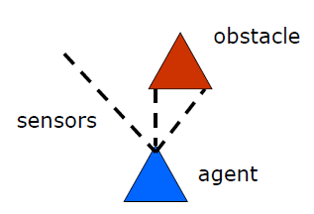
Using a look-up-table to encode f : P* → A
Example: Collision Avoidance
◦Sensors:3 proximity sensors
◦Effectors: Steering Wheel, Brakes
How to generate?
How large?
How to select action?

Slide 32
Using a look-up-table to encode f : P* → A
Example: Collision Avoidance
◦Sensors: 3 proximity sensors
◦Effectors: Steering Wheel, Brakes
How to generate: for each p ∈ P_{l} x P_{m} x P_{r}
generate an appropriate action, a ∈ S x B
How large: size of table = #possible percepts * #possible actions = |Pl | |Pm| |Pr| |S| |B|
E.g., P = {close, medium, far}³ A = {left, straight, right} {on, off}
then size of table = 27*3*2 = 162
How to select action? Search.

Slide 33
Agent types
Four basic types in order of increasing generality:
simple reflex agents
reflex agents with state
goal-based agents
utility-based agents
All these can be turned into learning agents

Slide 34
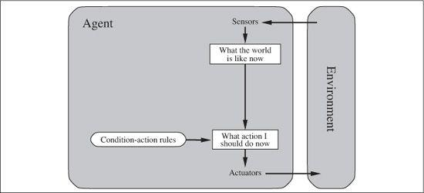
Simple reflex agents

Slide 35
Simple reflex agents
function Reflex-Vacuum-Agent( [location, status]) returns an action
if status = Dirty then return Suck
else if location = A then return Right
else if location = B then return Left

Slide 36
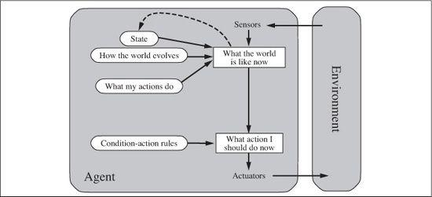
Reflex agents with state

Slide 37
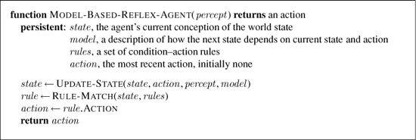
Reflex agents with state

Slide 38
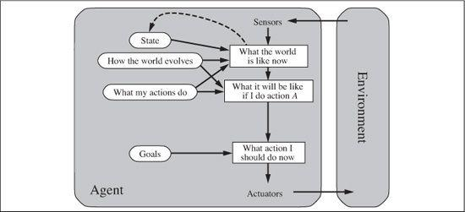
Goal-based agents

Slide 39
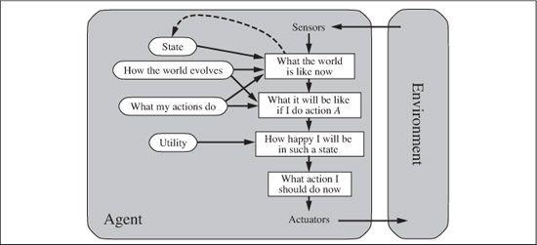
Utility-based agents

Slide 40
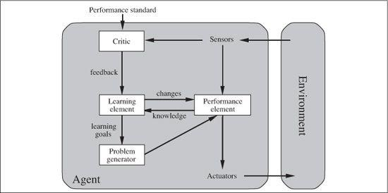
Learning agents

Slide 41
Summary
Agents interact with environments through actuators and sensors
The agent function describes what the agent does in all circumstances
The performance measure evaluates the environment sequence
A perfectly rational agent maximizes expected performance
Agent programs implement (some) agent functions
PEAS descriptions define task environments
Environments are categorized along several dimensions:
observable? deterministic? episodic? static? discrete? single-agent?
Several basic agent architectures exist:
reflex, reflex with state, goal-based, utility-based

